Slide 1
HW7 Topic: Blackbox and Individual Conditional Expectation
Wesley Duan

Slide 2
Introduction
States what to show to the reader.
Individual Conditional Expectation plots, produced by “black box” algorithms
Uses training data, {x_{i}, y_{i}} where i = 1,..., N the sample size.
(x_{i} = (x_{i,1} , …, x_{i,p}) is the vector of predictors and y_{i} is the response.
Construct model diagram that maps features x into fitted values.
ICE toolbox will help the visuals

Slide 3

Friedman’s PDP
PDP, let S ⊂ {1, ..., p} and let C be the complement set of S. Here S and C index subsets of predictors; for example, if S = {1, 2, 3}, then x_{S} refers to a 3 × 1 vector containing the values of the first three coordinates of x. Then the partial dependence function of f on x_{S} is given by
Y = 0.2X1 − 5X2 + 10X21X3≥0 + E

Slide 4
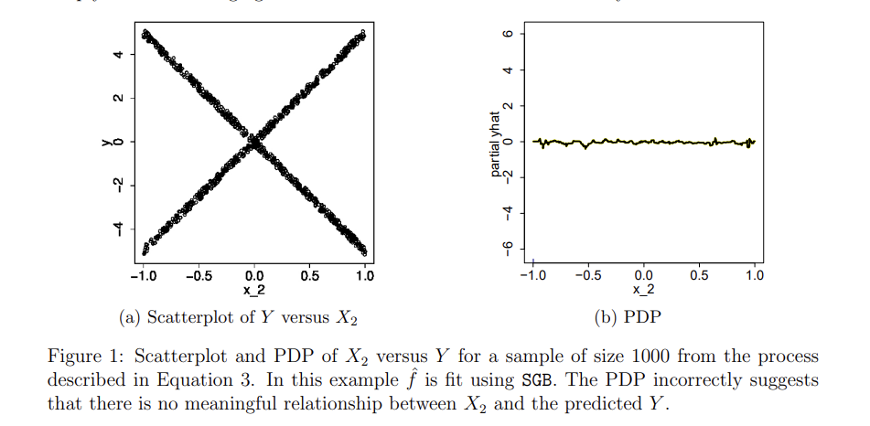
PDP and Scatterplot

Slide 5
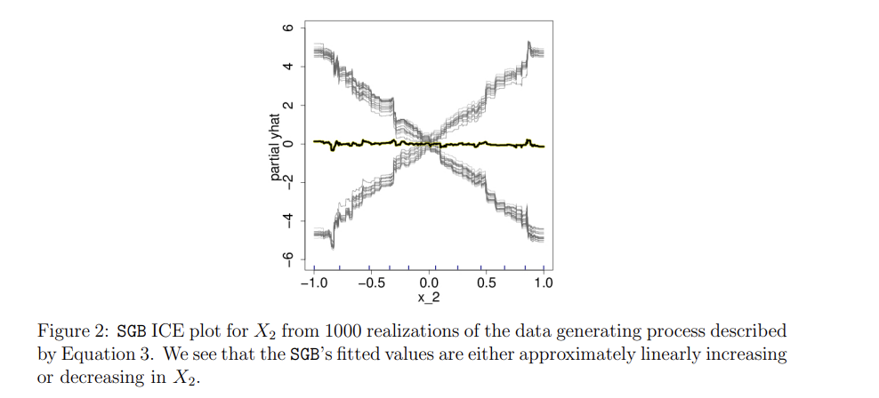
ICE Procedure
ICE plots disaggregate the output of classical PDPs.

Slide 6
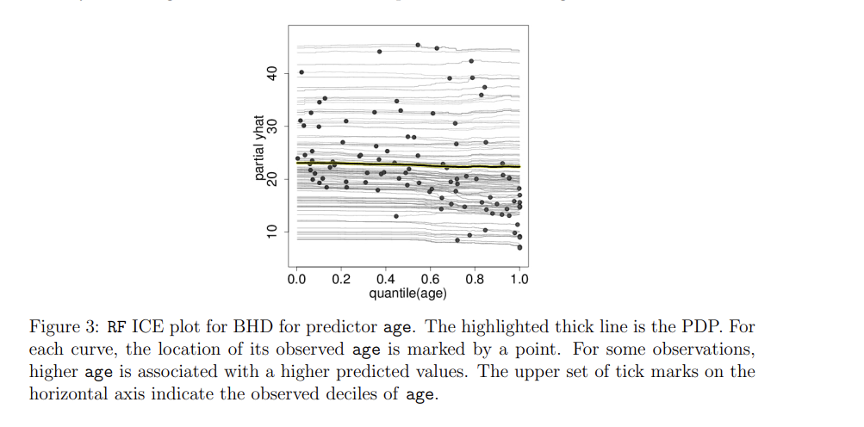
Boston Housing Data (BHD)
Use random forests implemented in R. Model association between average age of homes in census tract and corresponding median home value for S = age.

Slide 7
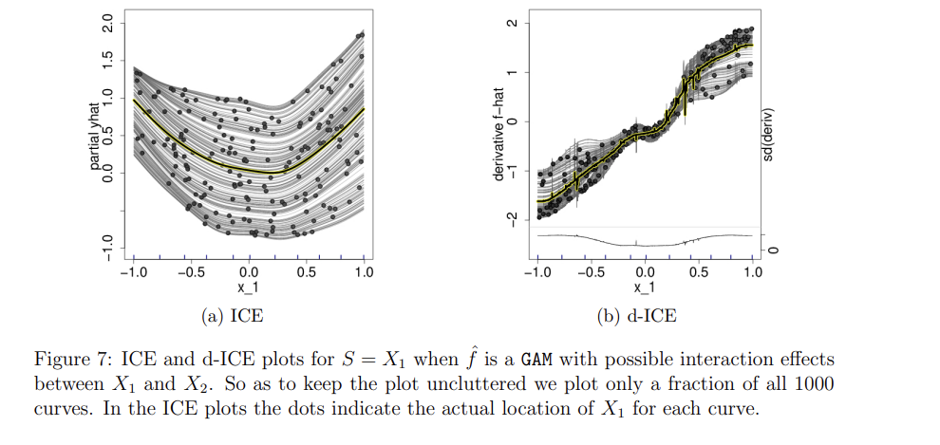
Additivity Assessment
We simulate 1000 independent (Xi , Yi) pairs according to the above and fit a generalized additive model (GAM, Hastie and Tibshirani, 1986) via the R package gam (Hastie, 2013). As we have specified it, the GAM assumes f(X) = f1(X1) + f2(X2) + f3(X1X2)

Slide 8
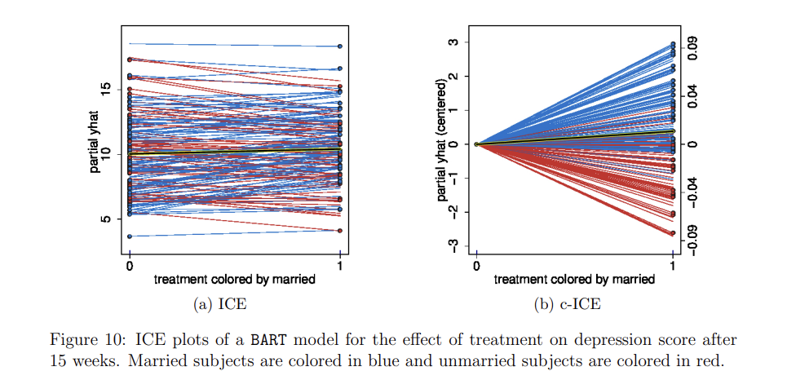
Real data example 1
Depression clinical trial where response variable is Hamilton Depression Rating Scale (lower scores correspond to being less depressed) after 15 weeks of treatment.
Placebo subjects focusing on a sample size of 156 subjects who received either one of the two treatments.
Binary treatment variable, with cognitive therapy “0” and paroxetine coded as “1”
Married subjects are in blue and unmarried are in red. R^2 = 0.40 and 37 covariates are in effect.
Nuanced predictor response relationships. Flat PDP obscures a complex relationship.

Slide 9
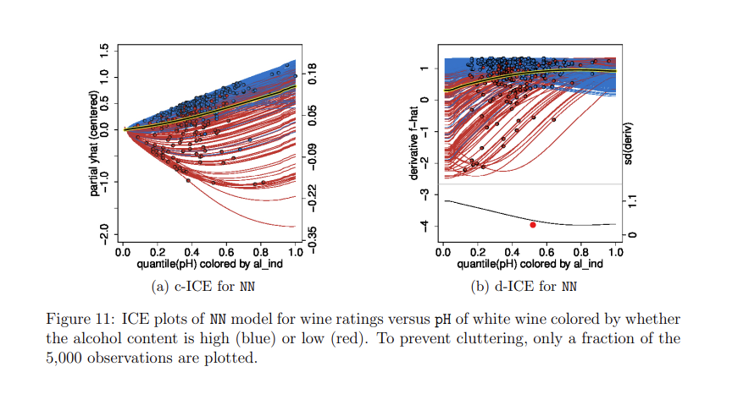
Real Data example 2
Wine ratings
11 covariates are physicochemical metrics that are commonly collected for wine quality control such as citric acid content, sulphates, etc.
PDP shows a linear tread, indicating that on average, higher pH is associated with higher fitted preference scores.
Area of increase has no data points so that increase is merely an extrapolation likely driven by the positive trend of high alcohol wines

Slide 10
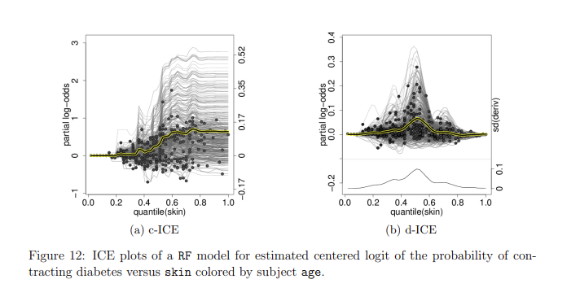
Diabetes classification example 3
This dataset is talked about 332 Pima Indians,obtained from MASS. 109 of the 332 subjects were diagnosed with diabetes. Binary response variable was fit using seven predictors (blood pressure, glucose concentration, etc)
Covariate skin thickness. Many subjects with high skin have a flat risk of diabetes. Figure 12b shows that the RF model fits interactions across the range of skin with the largest heterogeneity in effect occurring when skin is slightly above 30.

Slide 11
Paper Mechanics
When heterogeneity in ICE plots is observed, the researcher can adopt two mindsets. When one considers ˆf to be the fitted model used for subsequent predictions, the heterogeneity is of interest because it determines future fitted values. This is the mindset we have considered thus far. Separately, it might be interesting to ascertain whether interactions between xS and xC exist in the data generating model, denoted f.
Backfitting followed by random resampling, fitting y_b into X, display an ICE plot, then repeating the random sampling, to displaying ICE plot K-1 times then randomly inserting the true plot amongst these K-1 null plots. Want to the discovery to be valid for alpha = 1/K if view can correctly identify the true plot.

Slide 12
Ending
References
https://arxiv.org/pdf/1309.6392
Author: Alex Goldstein , Adam Kapelner, Justin Bleich , and Emil Pitkin

